Slide 1
Chapter 12:
Advanced Troubleshooting
IT Essentials v5.0
Notes:
Cisco Networking Academy program
IT Essentials v5.0
Chapter 12: Advanced Troubleshooting

Slide 2
Chapter 12 Objectives
12.0 Identify and practice advanced skills in troubleshooting techniques and diagnostic methods.
12.1 Identify and apply the steps of the troubleshooting process to solve Computer Components and Peripherals issues.
12.2 Identify and apply the steps of the troubleshooting process to solve Operating System issues.
12.3 Identify and apply the steps of the troubleshooting process to solve Network issues.
12.4 Identify and apply the steps of the troubleshooting process to solve Laptop issues.
12.5 Identify and apply the steps of the troubleshooting process to solve Printer issues.
12.6 Identify and apply the steps of the troubleshooting process to solve Security issues.
Notes:
Chapter 12 Objectives

Slide 3
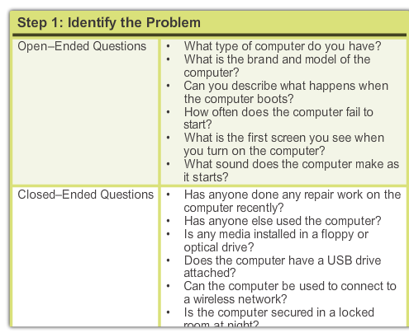
Apply Troubleshooting Process to Computer Components and Peripherals
Step 1 - Identify the Problem
Step 2 - Establish a Theory of Probable Cause
Step 3 - Test the Theory to Determine cause
Step 4 - Establish a Plan of Action to Resolve the Problem and Implement the Solution
Step 5 - Verify Full System Functionality and Implement Preventative Measures
Step 6 - Document Findings, Actions, and Outcomes
Notes:
12.1.1.1 Apply Troubleshooting Process to Computer Components and Peripherals

Slide 4
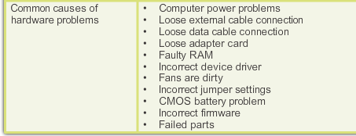
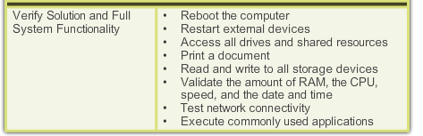
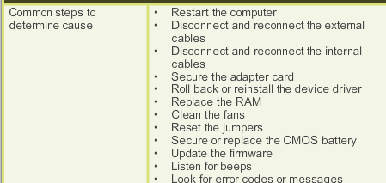
Apply Troubleshooting Process to Computer Components and Peripherals
Step 1 – Identify the Problem.
Step 4 – Establish a plan of action to resolve the problem and implement the solution.
Step 2 – Establish a Theory of Probable Cause.
Step 5 – Verify Full System Functionality and, if applicable, Implement Preventive Measures.
Step 3 – Test the Theory to Determine Cause.
Step 6 – Document Findings, Actions and Outcomes.
Notes:
12.1.1.1 Apply Troubleshooting Process to Computer Components and Peripherals
12.1.1.2 Common Problems and Solutions for Components and Peripherals
See chart in Curriculum

Slide 5
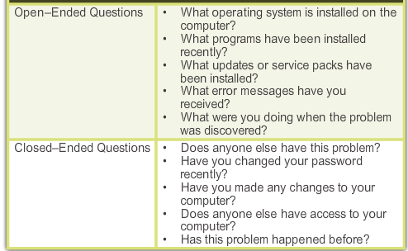
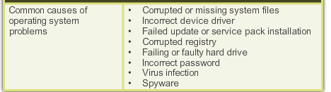
Apply Troubleshooting Process to Operating Systems
Step 1 – Identify the Problem.
Step 2 – Establish a Theory of Probable Cause.
Notes:
12.2.1.1 Apply Troubleshooting Process to Operating Systems

Slide 6
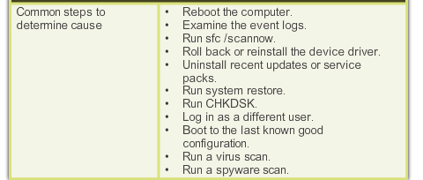
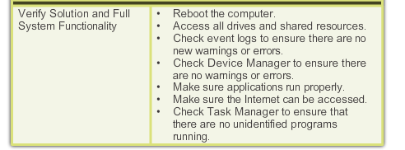
Apply Troubleshooting Process to Operating Systems (Continued)
Step 3 – Test the Theory to Determine Cause.
Step 5 – Verify Full System Functionality and, if applicable, Implement Preventive Measures.
Step 4 – Establish a Plan of Action to Resolve the Problem and Implement the Solution.
Step 6 – Document Findings, Actions and Outcomes.
Notes:
12.2.1.1 Apply Troubleshooting Process to Operating Systems (Continued)

Slide 7
Common Problems and Solutions for Operating Systems
Operating system problems can be attributed to hardware, software, network, or some combination of the three.
A stop error is a hardware or software malfunction that causes the system to lock up, for example:
  The Blue Screen of Death (BSOD) appears when the system is unable to recover from an error.
The Event Log and other diagnostic utilities are available to research a stop error or BSOD error.
See Chart of Common Problems and Solutions in the curriculum.
Notes:
12.2.1.2 Common Problems and Solutions for Operating Systems

Slide 8
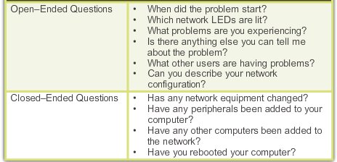
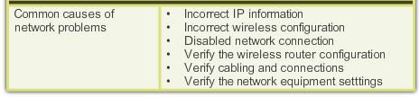
Apply Troubleshooting Process to Networks
Step 1 – Identify the Problem.
Step 2 – Establish a Theory of Probable Cause.
Notes:
12.3.1.1 Apply Troubleshooting Process to Networks

Slide 9
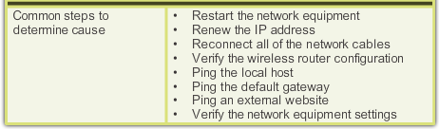
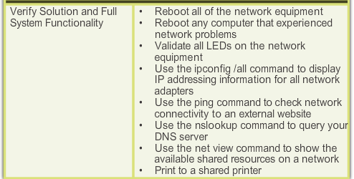
Apply Troubleshooting Process to Networks
Step 3 – Test the Theory to Determine Cause.
Step 5 – Verify Full System Functionality and, if applicable, Implement Preventive Measures.
Step 4 – Establish a Plan of Action to Resolve the Problem and Implement the Solution.
Step 6 – Document Findings, Actions and Outcomes.
Notes:
12.3.1.1 Apply Troubleshooting Process to Networks (Continued)

Slide 10
Common Problems and Solutions for Networks
Network problems can be attributed to hardware, software, network, or some combination of the three.
Network Connection Problems:
  Often caused by incorrect TCP/IP configurations, firewall settings, or failed devices.
Email Failure:
  Often caused by incorrect email software settings, firewall settings, or hardware connectivity issues.
FTP and Secure Internet Connection Problems:
  Often caused by incorrect IP address, port setting, or security policy.
See Chart of Common Problems and Solutions in the curriculum.
Notes:
12.3.1.2 Common Problems and Solutions for Networks

Slide 11
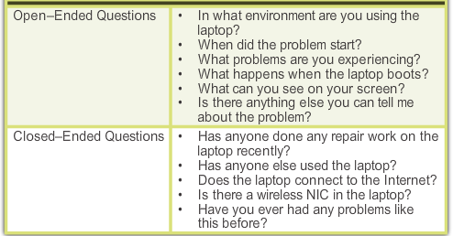
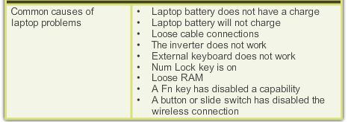
Apply Troubleshooting Process to Laptops
Step 1 – Identify the Problem.
Step 2 – Establish a Theory of Probable Cause.
Notes:
12.4.1.1 Apply Troubleshooting Process to Laptops

Slide 12
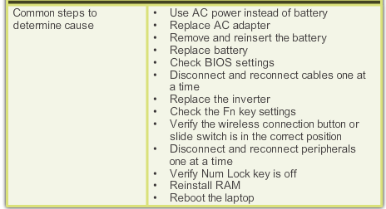
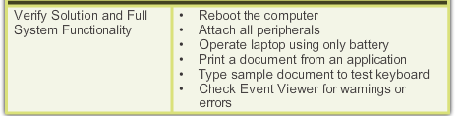
Apply Troubleshooting Process to Laptops (Continued)
Step 3 – Test the Theory to Determine Cause.
Step 5 – Verify Full System Functionality and, if applicable, Implement Preventive Measures.
Step 6 – Document Findings, Actions and Outcomes.
Step 4 – Establish a Plan of Action to Resolve the Problem and Implement the Solution.
Notes:
12.4.1.1 Apply Troubleshooting Process to Laptops (Continued)
12.4.1.2 Common Problems and Solutions for Laptops

Slide 13
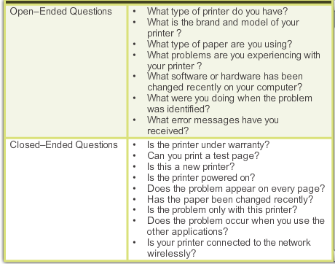
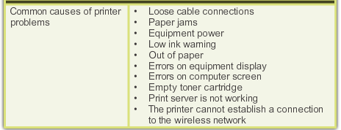
Apply Troubleshooting Process to Printers
Step 1 – Identify the Problem.
Step 2 – Establish a Theory of Probable Cause.
Notes:
12.5.1.1 Apply Troubleshooting Process to Printers

Slide 14
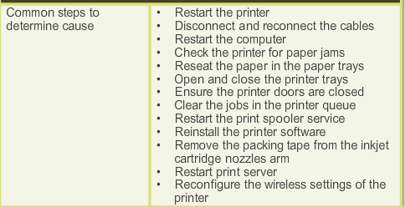
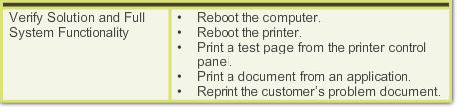
Apply Troubleshooting Process to Printers (continued)
Step 3 – Test the Theory to Determine Cause.
Step 5 – Verify Full System Functionality and, if applicable, Implement Preventive Measures.
Step 6 – Document Findings, Actions and Outcomes.
Step 4 – Establish a Plan of Action to Resolve the Problem and Implement the Solution.
Notes:
12.5.1.1 Apply Troubleshooting Process to Printers (Continued)
12.5.1.2 Common Problems and Solutions for Printers

Slide 15
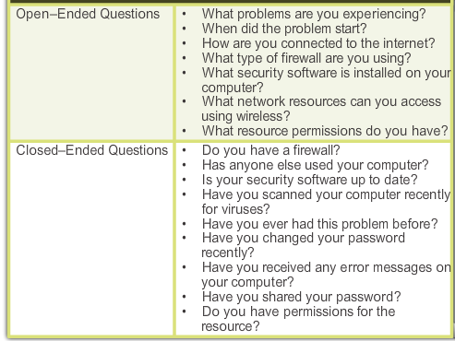
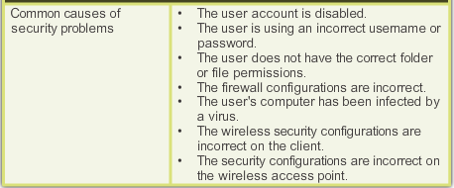
Apply Troubleshooting Process to Security
Step 1 – Identify the Problem.
Step 2 – Establish a Theory of Probable Cause.
Notes:
12.6.1.1 Apply Troubleshooting Process to Security

Slide 16
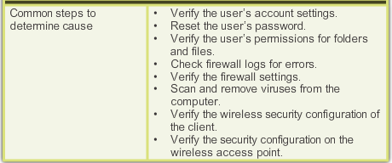
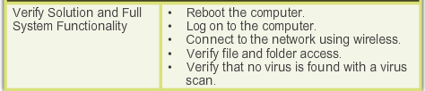
Apply Troubleshooting Process to Security (Continued)
Step 3 – Test the Theory to Determine Cause.
Step 5 – Verify Full System Functionality and, if applicable, Implement Preventive Measures.
Step 6 – Document Findings, Actions and Outcomes.
Step 4 – Establish a Plan of Action to Resolve the Problem and Implement the Solution.
Notes:
12.6.1.1 Apply Troubleshooting Process to Security (continued)

Slide 17
Common Problems and Solutions for Security
Security problems can be attributed to hardware, software, network, or some combination of the three.
Malware Settings:
  Malware protection problems are often related to incorrect software settings or configurations.
User Accounts and Permissions:
  Unauthorized access or blocked access is often caused by incorrect user account settings or incorrect permissions.
Computer Security Problems:
  Can be caused by incorrect security settings in the BIOS or on the hard drive.
Firewall and Proxy Settings:
  Blocked connections to resources and the Internet are often related to incorrect firewall and proxy rules.
See Chart of Common Problems and Solutions in the curriculum.
Notes:
12.6.1.2 Common Problems and Solutions for Security

Slide 18
Chapter 12 Summary
This chapter described how to apply the six step troubleshooting process to advanced problems.
This chapter also presented advanced diagnostic questions to ask when gathering information about a computer hardware or software problem.
It described more advanced versions of common problems and solutions for Computer Components and Peripherals, Operating Systems, Networks, Laptops, Printers, and Security.
It explained techniques to troubleshoot more complex hardware and software problems.
Notes:
Chapter 12 Summary

Slide 19


